Slide 1


A New Planetary Ethics & Good, Clean and Fair ICT
School of Business, Law and Entrepreneurship
Online Learning Materiel

Slide 2
Reflecting on the ethical dimensions of the ICT industry and Profession
Sensitise yourself to global challenges such as poverty, inequality and resource depletion
Understand the role ICTs play in both contributing to the problem and generating solutions
Understand why a reassessment of values is required to implement alternative strategies from unsustainable profit-driven approaches to responsible, united and biocompatible approaches.
Be able to argue the ethical underpinnings of proposed solutions to these challenges
Objectives:
Ethical Theories of Tomorrow

Slide 3
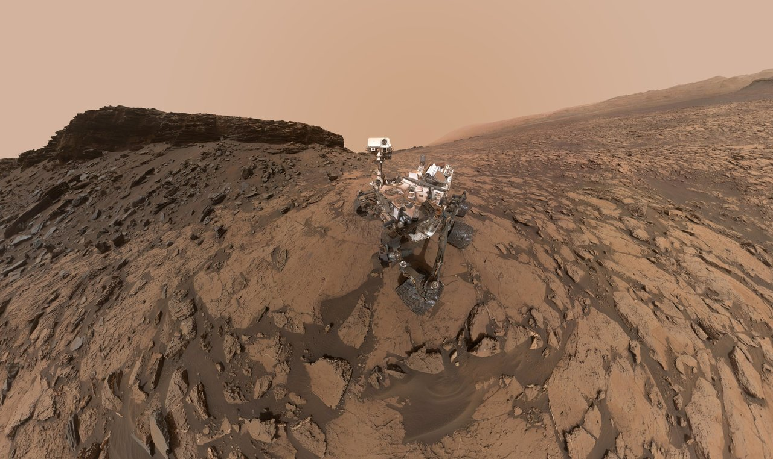
Current global challenges imply a need for planetary ethics
Planetary Ethics
“
“

Slide 4
Planetary ethics: External Challenges
Creating a compromise-based model of global human integration
Moral-ethical justification of limiting economic, needs
Promoting bio-centric, and environmental values and motives
Considering the needs of future generations

Slide 5
Planetary ethics: Internal Challenges
Clear formulation of the planetary environmental imperative
Development of the idea that the world of nature and people are a single living organism
Review of economic development and progress in relation to society and bio-centric consciousness that considers the needs of future generations

Slide 6
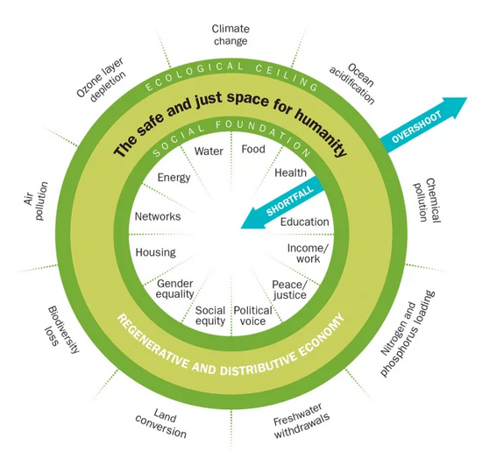
Doughnut Economics
Why it's time for Doughnut Economics
Raworth, Kate
IPPR progressive review, 2017, Vol.24 (3), p.216-222

Slide 7
Ethics and Tech
“
“
Students learn to ask not simply “Can I build it?” but rather “Should I build it, and if so, how?”

Slide 8
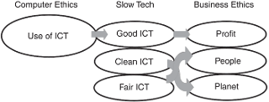
Good/Clean/Fair ICT
A lot of discussion on Information ethics but little action
Green ICT is probably the most investigated area of the three good forms of ICT involved in Good/Clean/Fair ICT
Notes:
Within the world of ICT the technology lifecycle and the long-term sustainability of ICT are beginning to be assessed from both the environmental and social points of view
That, contrary to Moore’s law, there are constraints to ICT growth, particularly around its impact on human beings, the environment and society.

Slide 9
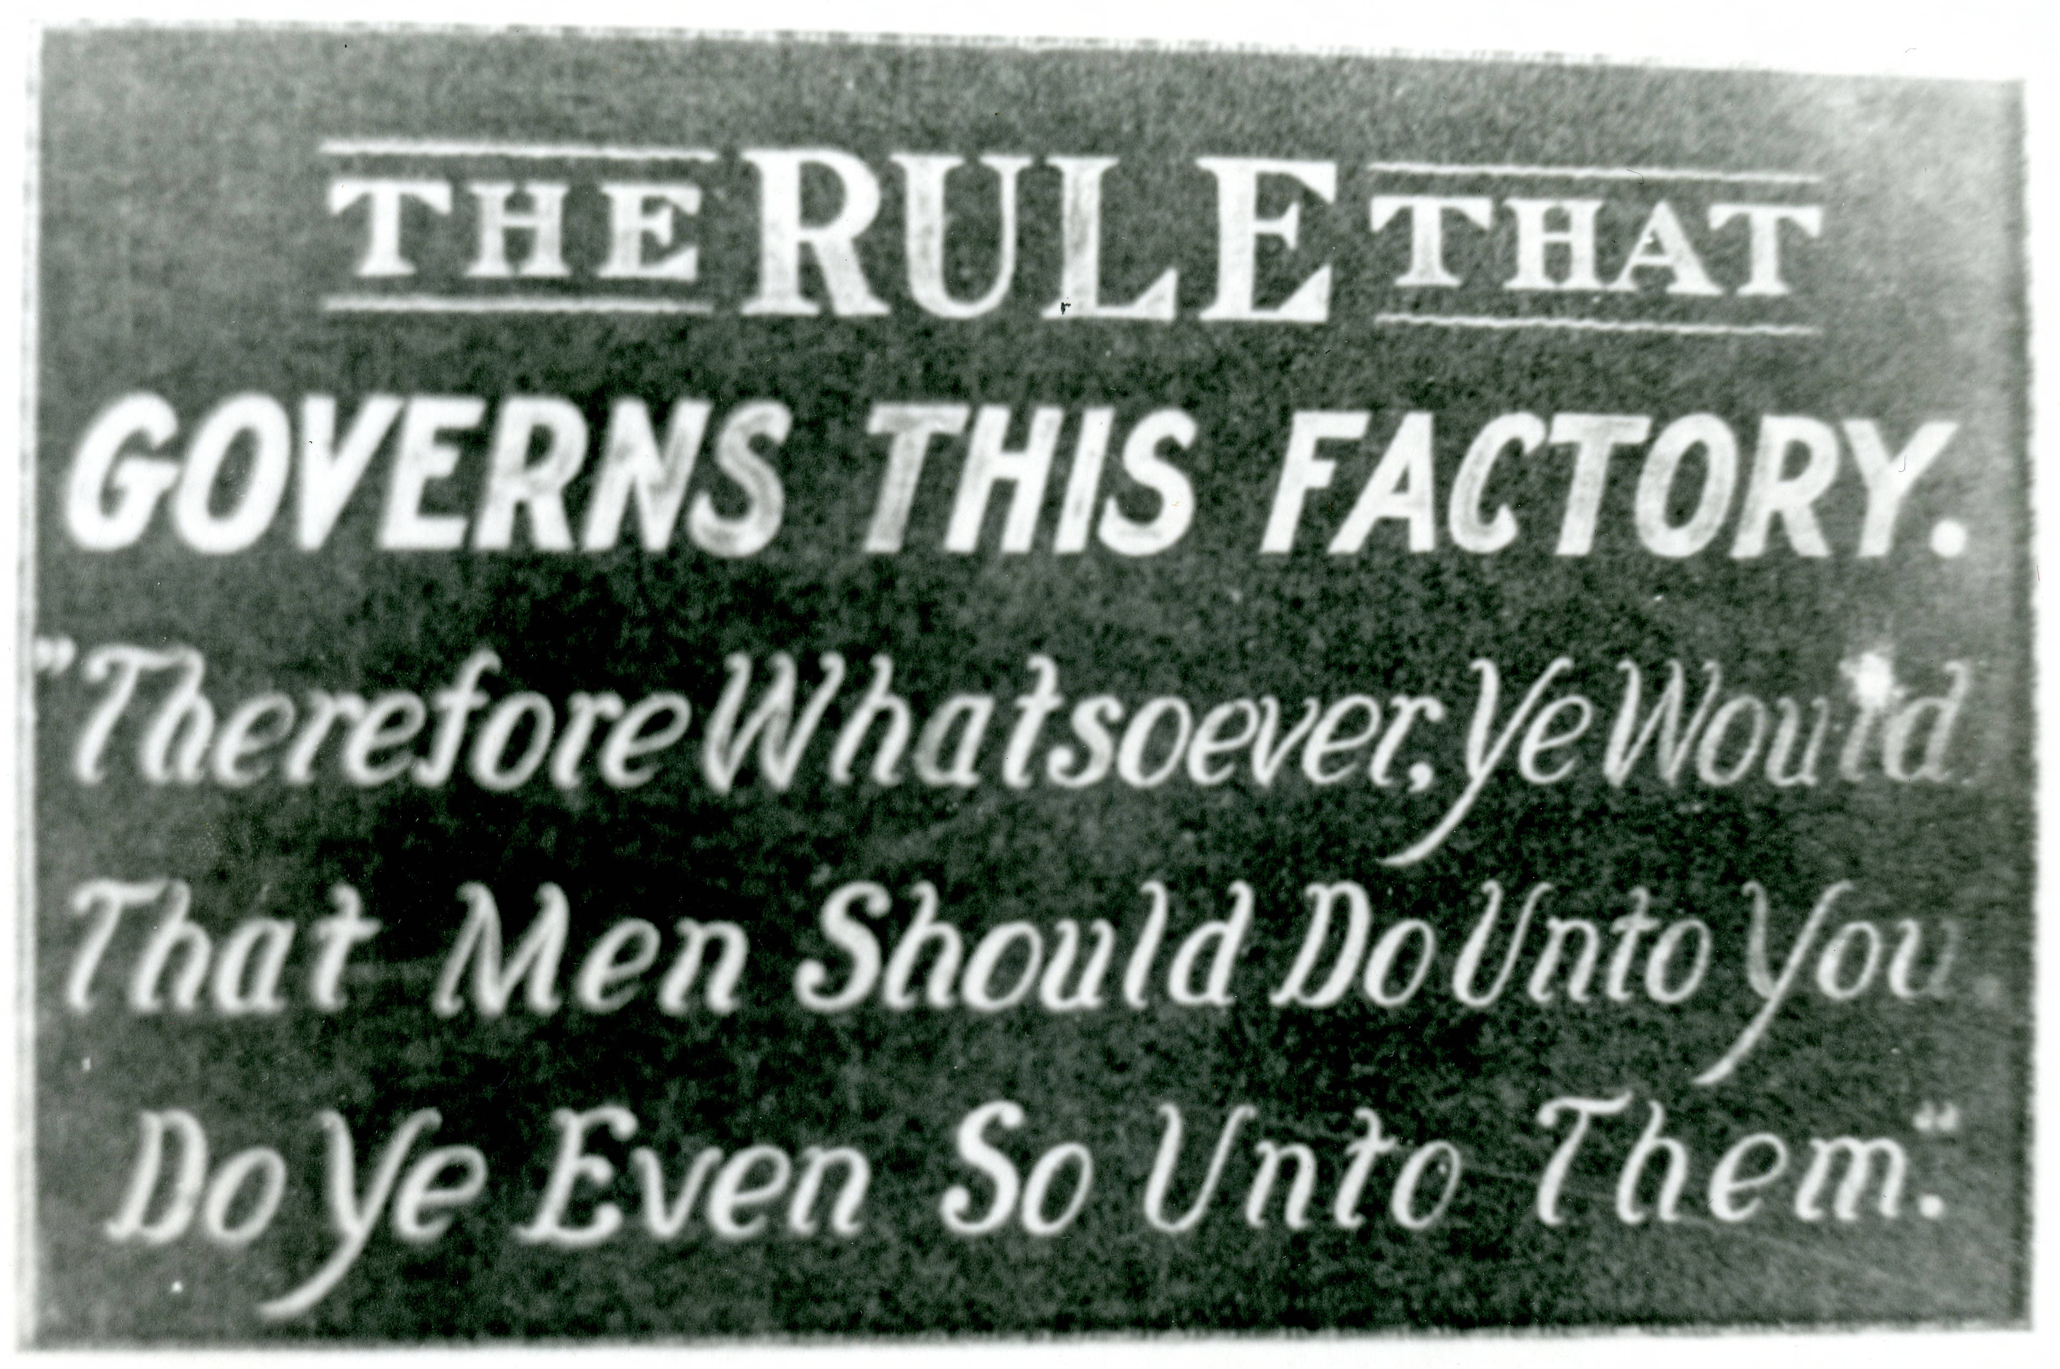
Past 20 years of Information Ethics
Participatory Design
Value Sensitive Design
Impacts of Technologies of the Future
Notes:
Good Clean Fair ICT seeks to place human beings, society, sustainability and the planet as core to the development of science and technology.

Slide 10

Origins and main themes of Good/Clean/Fair ICT
Notes:
signals a departure away from the traditional position of technology push and from the mantra that technology is driving the future. Rather, it is human beings and society that should now form the starting point of ICT design
It reflects the need for a more proactive form of computer ethics

Slide 11
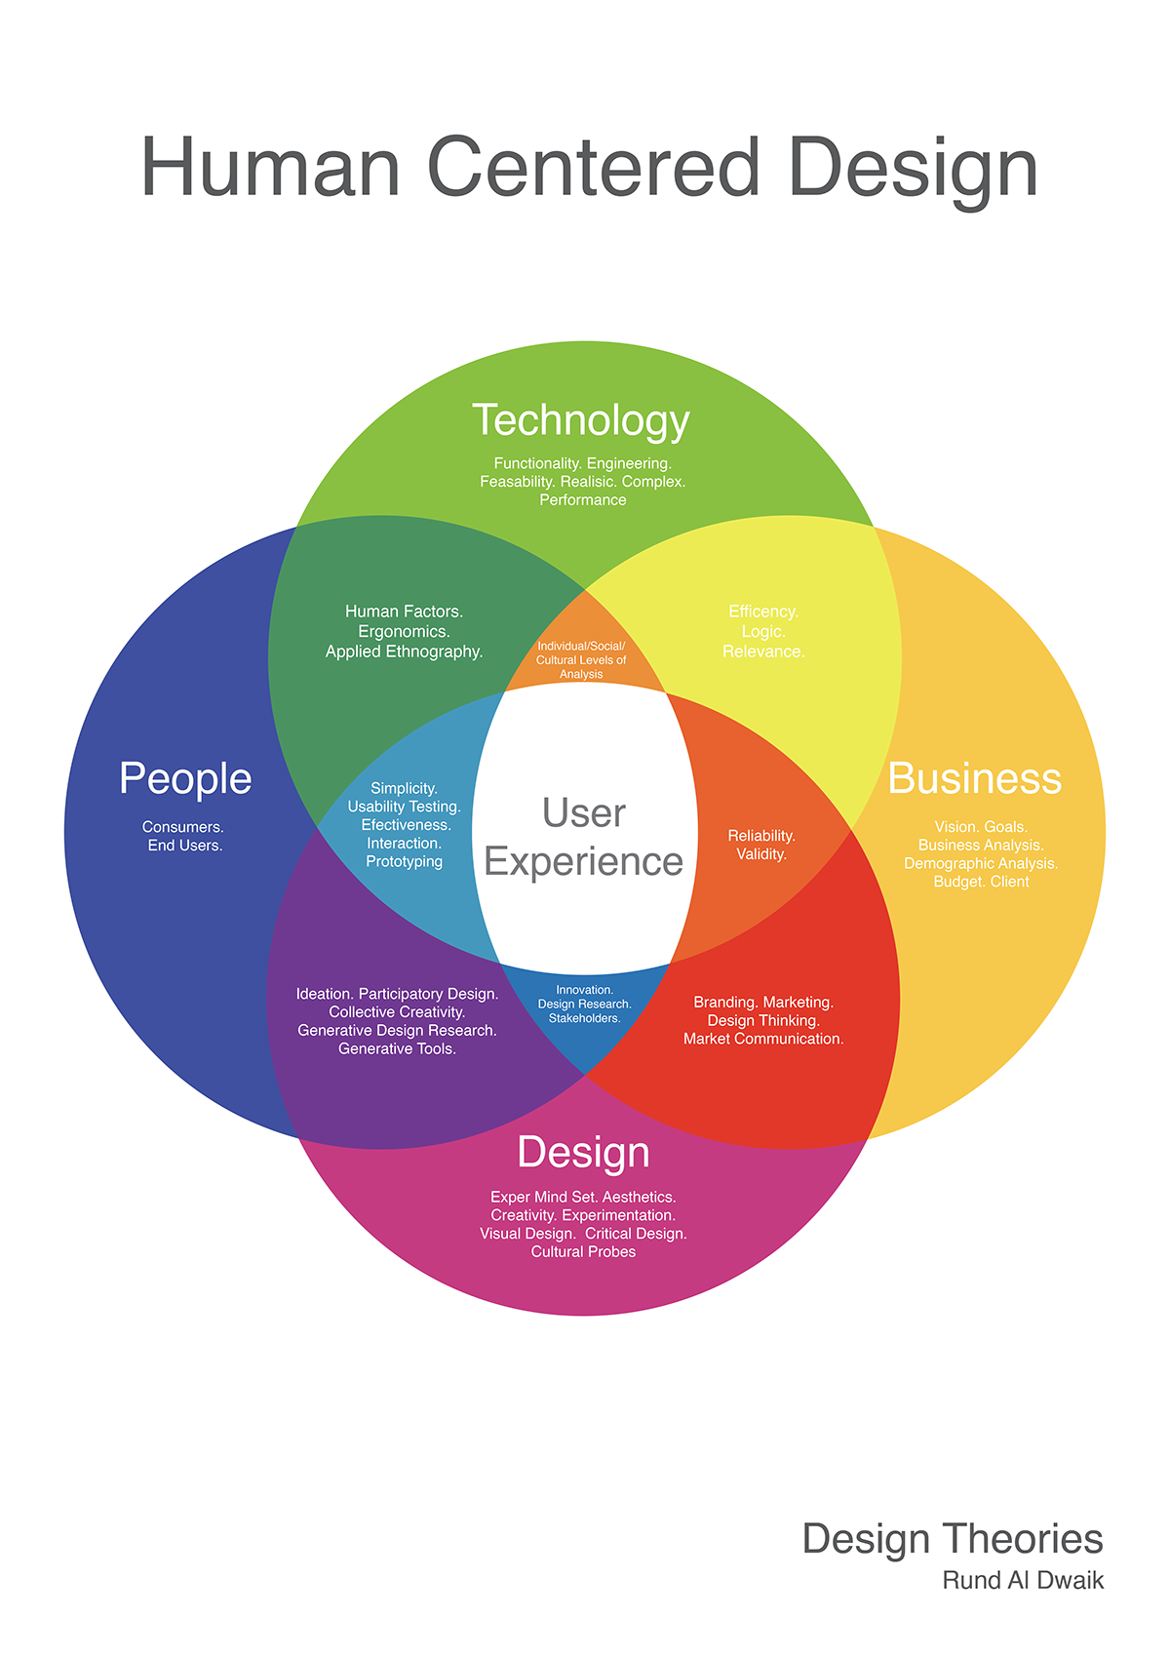
Good ICT
Notes:
ICT could be good for human beings when the systems are designed by using a human-centred approach. In this case, good means good for the essential well-being of human-beings.
Good ICT means taking into account human well-being , so that it supports people in, for example, enhancing their health or help elderly people or people with disabilities to live a better quality of life for example.
Good ICT must involve users and society in the design stage itself as well as later parts of the ICT lifecycle, This approach to ICT systems development is called Participatory Design.
In summary, good ICT means human-centred ICT: technologies that improve human well-being and wellliving.

Slide 12
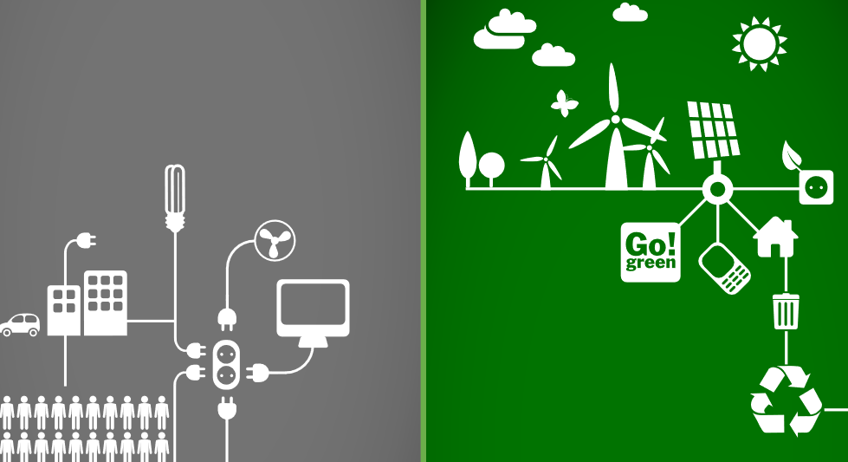
Clean ICT
Notes:
Clean ICT focuses on avoiding harm to the environment and human health. Clean ICT means developing computer systems and networks that are respectful of the planet, and that are designed and produced while taking into account their impact on the environment
Tech, however, generates toxic hazards throughout its lifecycle (from its design, production, and consumption to its disposal)
For example, until few years ago, the primary elements used in microprocessors (the rare-earths) were never considered from the sustainability point of view.
A major environmental challenge is arising from the need to provide the power to operate ICT: in the cloud computing era, the energy necessary to power gigantic data centres doubles every five years
Clean ICT involves a quest to slow down the ICT life cycle. It aims to minimise any harm done by the production and use of ICT, and – more generally – to extend the life cycle of ICT products by reducing the replacement rate of ICT devices. It also represents two challenges: on the demand side, the desire to accumulate material goods and to follow only the latest fashions or trends in electronic devices, and on the supply side, to the rush to make a short-term profit. The concept of recyclable-by-design is starting to appear in the ICT world as a welcome proactive step in the appropriate direction.

Slide 13

Fair ICT
Notes:
Fair ICT can be defined as being respectful of the human rights, self esteem, and health and safety, of workers in ICT manufacturing as well as of ICT users. Fair ICT must take into account the interests of all types of actors involved throughout the entire ICT stakeholders’ network
Among the many issues involved in creating fair ICT, to the fore is the need to secure a good quality of working life for all, wherever the workers are located around the globe and whatever their age.
Fair ICT also means open ICT, an ICT that contributes positively to the economy and society through the enabling of innovation potential. When the two concepts of open software and open hardware are applied to ICT, it becomes possible to imagine the immense innovation potential of ICT.
Fair ICT drives the achievement of a balance among the interests of all the stakeholders, including the workers and the planet. Aiming for fair ICT will help ICT companies and organisations to realise that there are many actors involved in their stakeholders' network who have a wide range of differing interests.

Slide 14
The key question is the control of the [sic] time. We would need more time to take some decisions. The rhythm of the computers and of the telecommunication systems is not the rhythm of time which is needed to take meaningful decisions (Weizenbaum, 1991).
Fair ICT

Slide 15
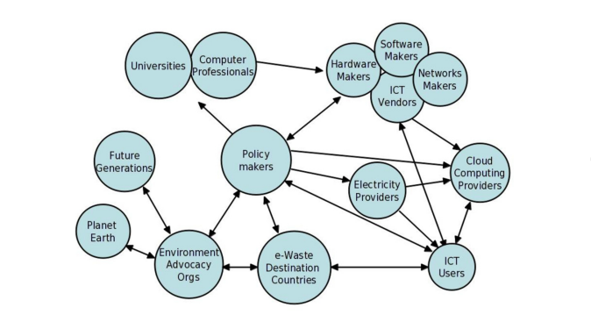
ICT Stakeholders

Slide 16


